Slide 1
Jenkins

Slide 2
Jenkins
Jenkins is a DevOps tool for Continuous Integration
Jenkins is installed on the central build server.
Continuous Integration: Continuous Integration is a DevOps software development method where the developers merge their code changes into a central repository after which automated builds and tests are run.
If Jenkins detects any changes in the source code , it triggers required builds and tests. The results of the builds and tests would be available on Dashboard (Notifications can also be sent).

Slide 3
Installing Jenkins
Minimum hardware requirements:
256 MB of RAM
1 GB of drive space (although 10 GB is a recommended minimum if running Jenkins as a Docker container)
Recommended hardware configuration for a small team:
1 GB+ of RAM
50 GB+ of drive space
Software requirements
Java 8 and above
Web browser

Slide 4
Installing Jenkins
Mac OS X:
Command: brew install jenkins
Debian/Ubuntu:
wget -q -O - https://pkg.jenkins.io/debian/jenkins.io.key | sudo apt-key add - sudo sh -c 'echo deb http://pkg.jenkins.io/debian-stable binary/ > /etc/apt/sources.list.d/jenkins.list’
sudo apt-get update
sudo apt-get install jenkins
After installation you can find jenkins on http://localhost:8080 .
Open Jenkins and follow the instructions on the browser.

Slide 5
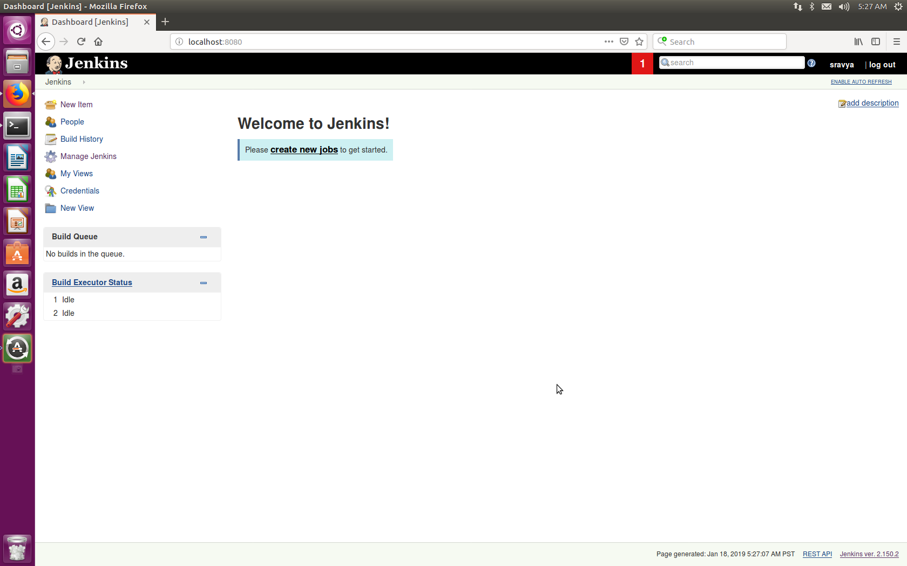
Jenkins First look

Slide 6
Configuring Jenkins for a small project on Github
On Jenkins Dashboard click on ”New Item”
Select “Free Style Project” and enter a name for the project.
In ”Source Code Management” Tab select “Git”.Enter the url of the repository.I used my trail repository( https://github.com/sravya5959/Jenkins_trail/) It has a simple “hello world” program.
In the “Build” tab enter the build command. (If using the above mentioned repo “gcc hello.c”
Click on “Save”

Slide 7
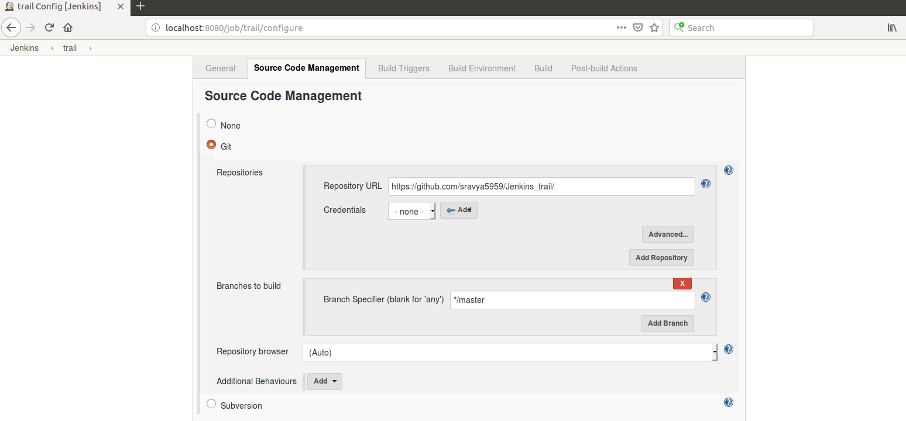
Configuring Jenkins for a small project on Github

Slide 8
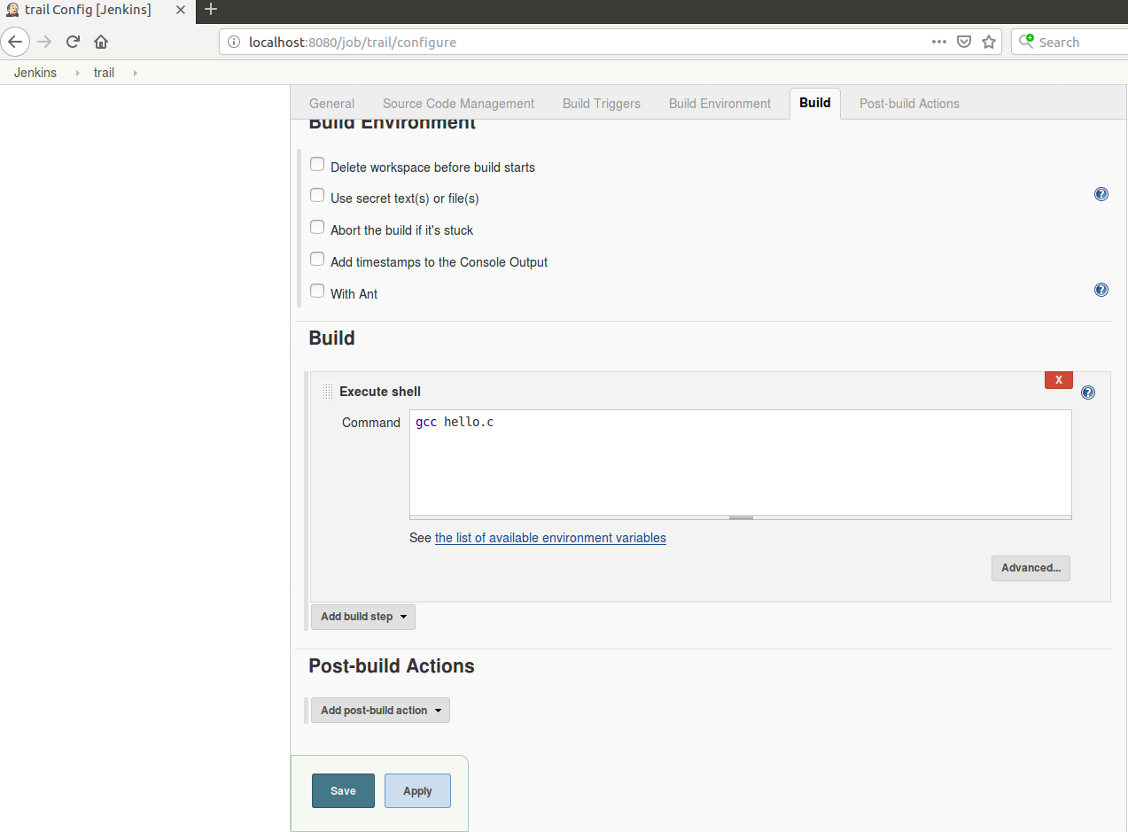
Configuring Jenkins for a small project on Github

Slide 9
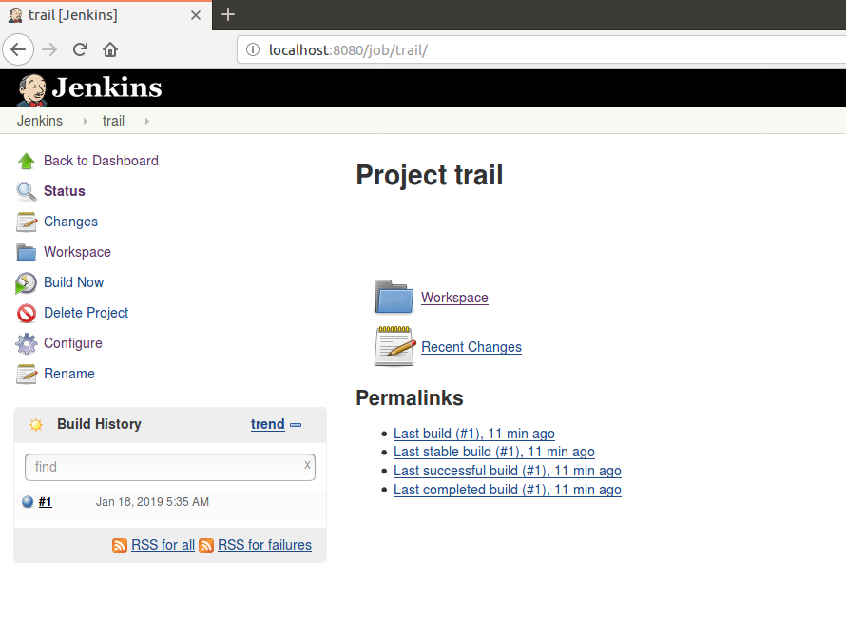
After configuring…
Click on “build now”

Slide 10
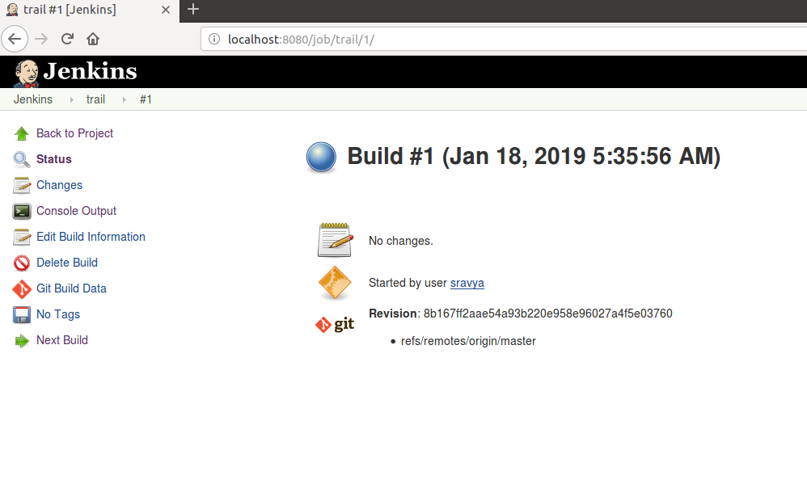
After build is completed..
Click on the build number(#1)

Slide 11
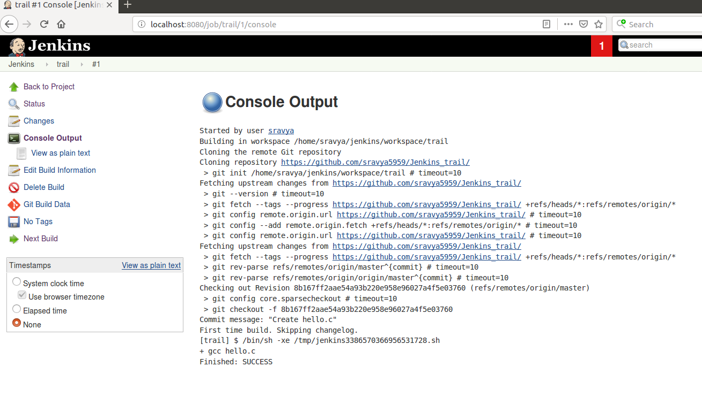
After build is completed..
Click on “console output”

Slide 12
Add Email Notifications to the Project…
To enable Email Notifications, Sender address must be configured in Jenkins settings.
Go to Jenkins Dashboard.
Click on “Manage Jenkins”
Then Click on “configure system”
Go to “Email Notification tab” enter the credentials.
If using Gmail to send emails.
SMTP Server: smtp.gmail.com
Select “Use SMTP Authentication”
Enter your gmail username and password.
Select “use ssl”
SMTP port : 465
Click on “save”

Slide 13
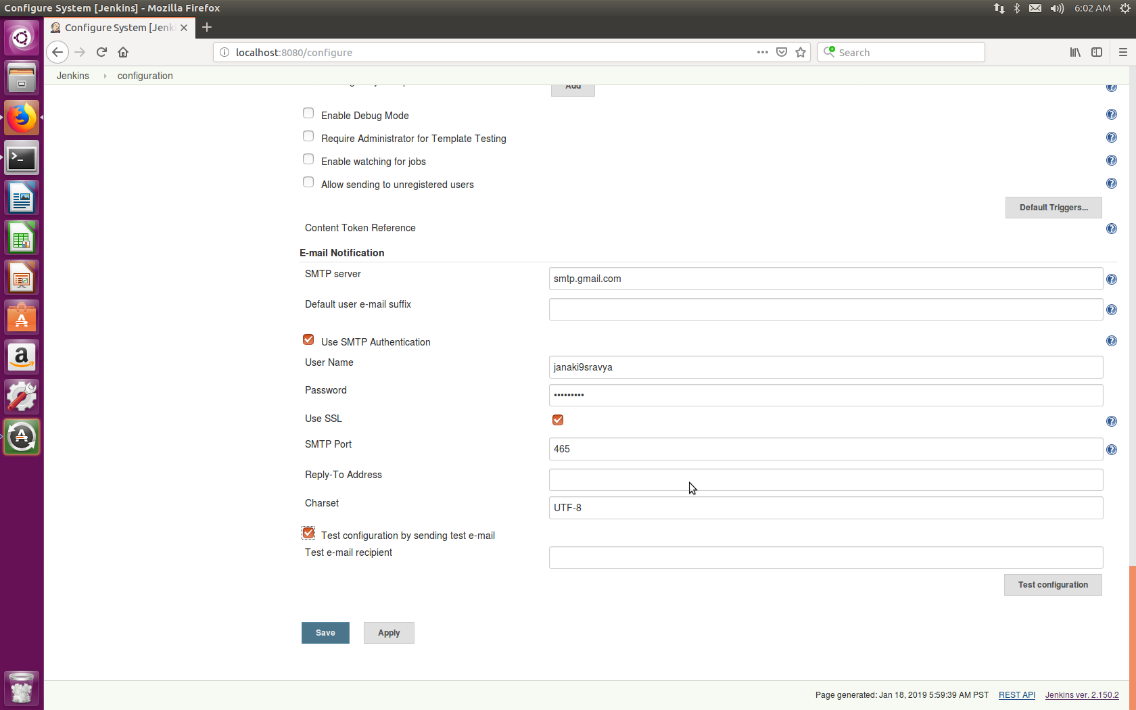
Add Email Notifications to the Project…

Slide 14
Configuring Gmail to allow sending Emails
After configuring Sender’s address on Jenkins, we need to configure Gmail to allow sending Emails.
Gmail does not allow Jenkins to send emails since it detects it as an insecure app.
Therefore we need to turn on ”Less Secure App Access”
Login to the Gmail account configured in Jenkins
Go to Settings
Click on “Accounts and Imports” Tab
In ”Change account settings” click on “Other Google Account Settings”

Slide 15
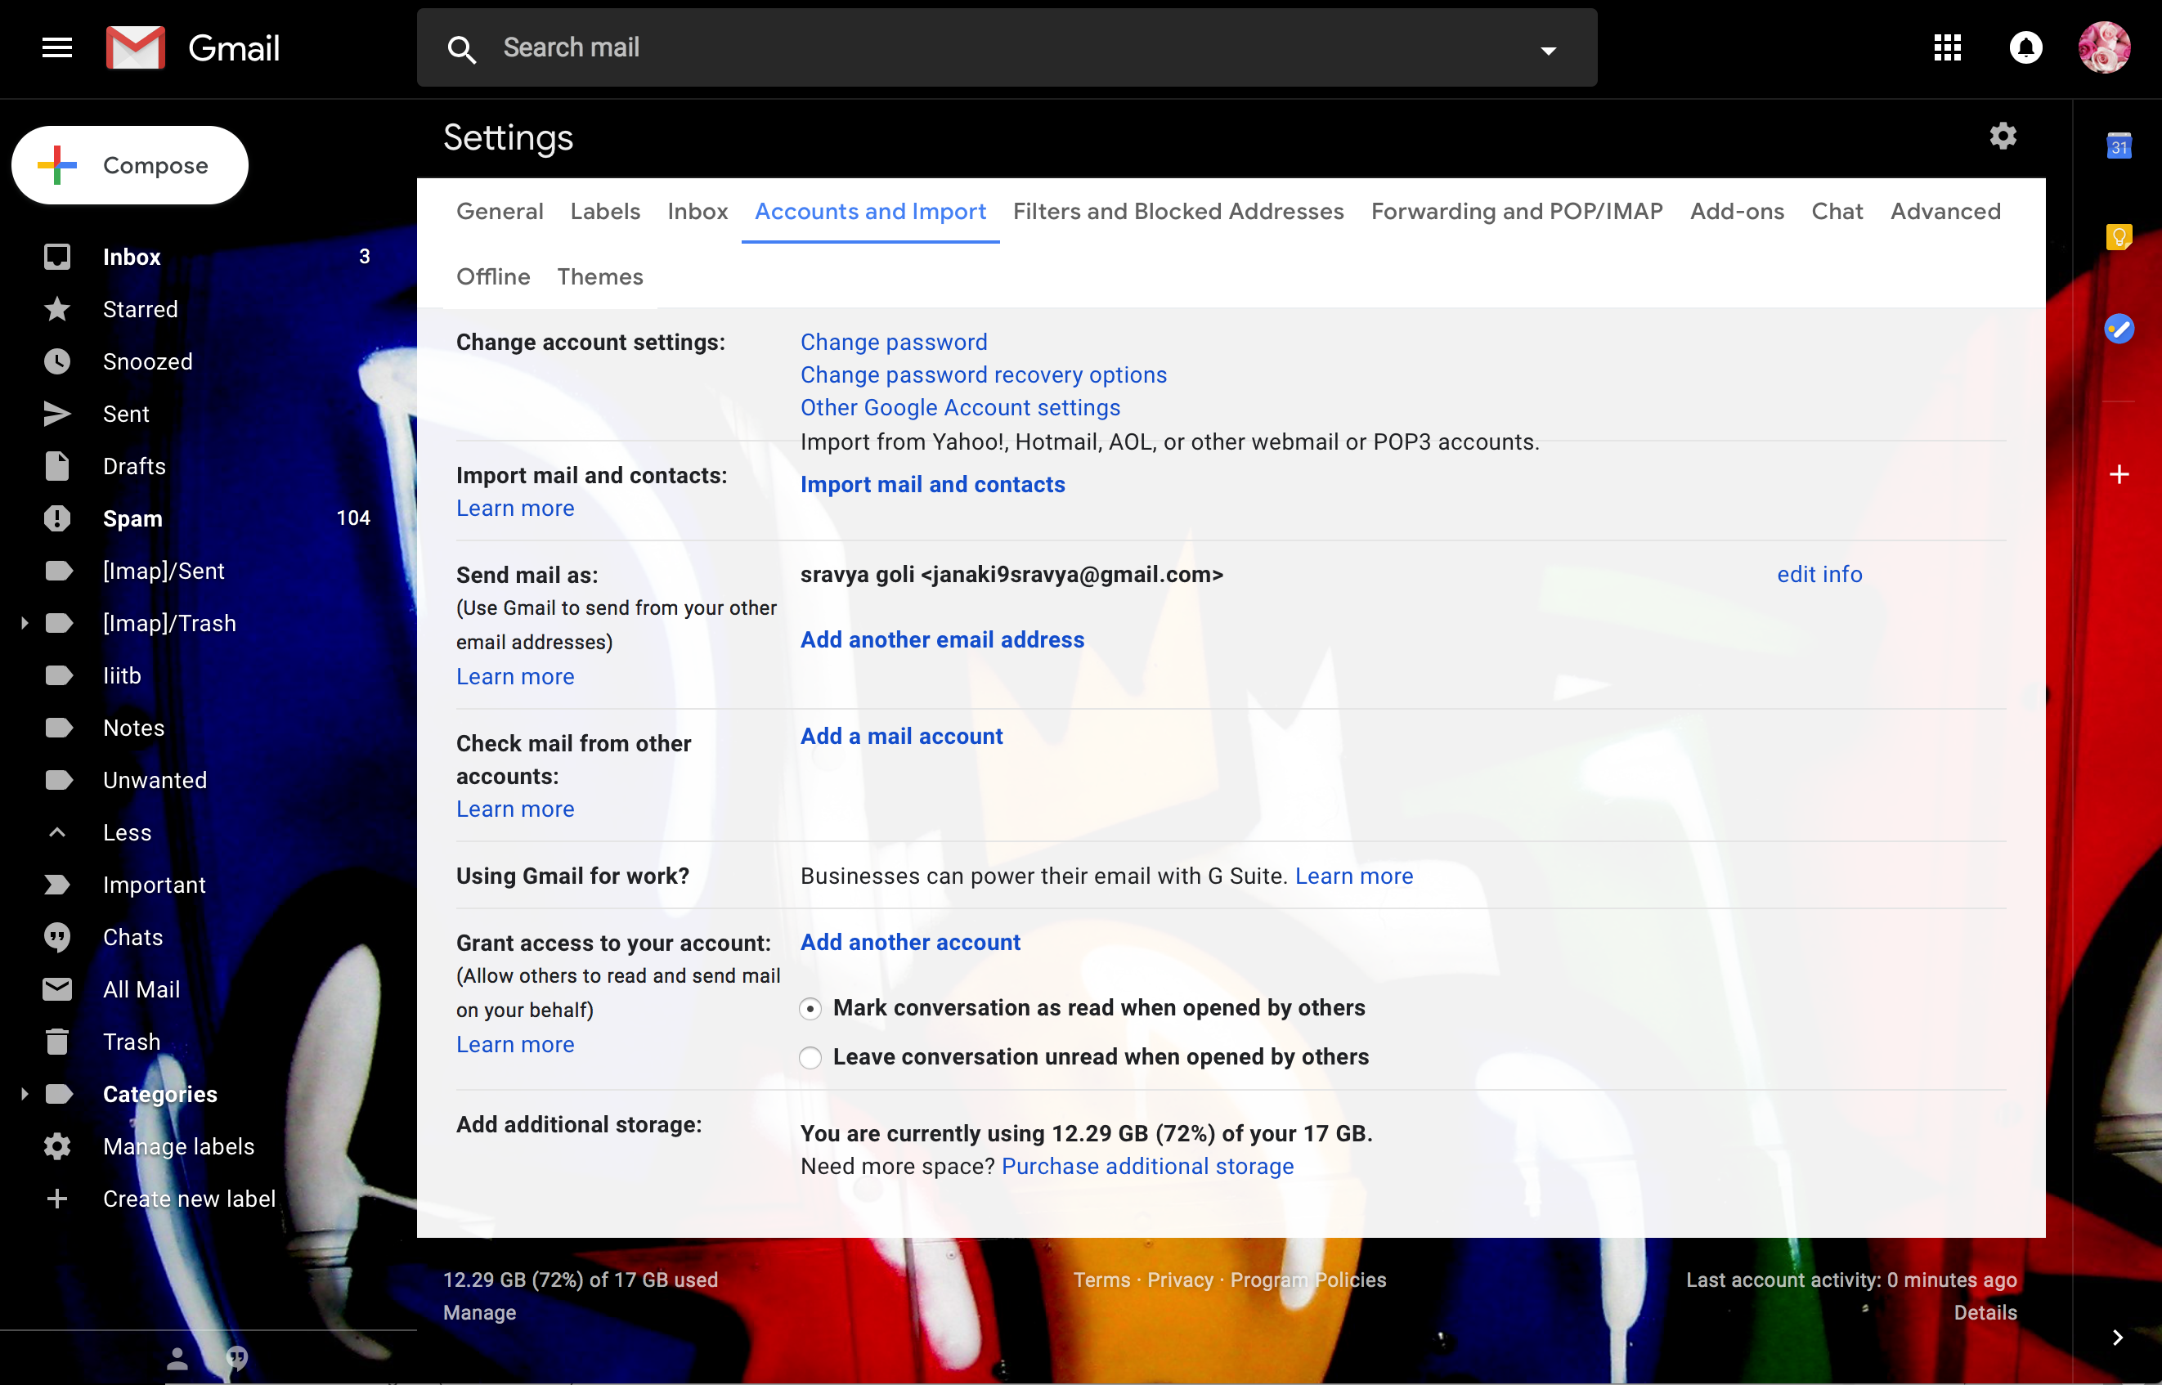
Configuring Gmail to allow sending Emails..

Slide 16
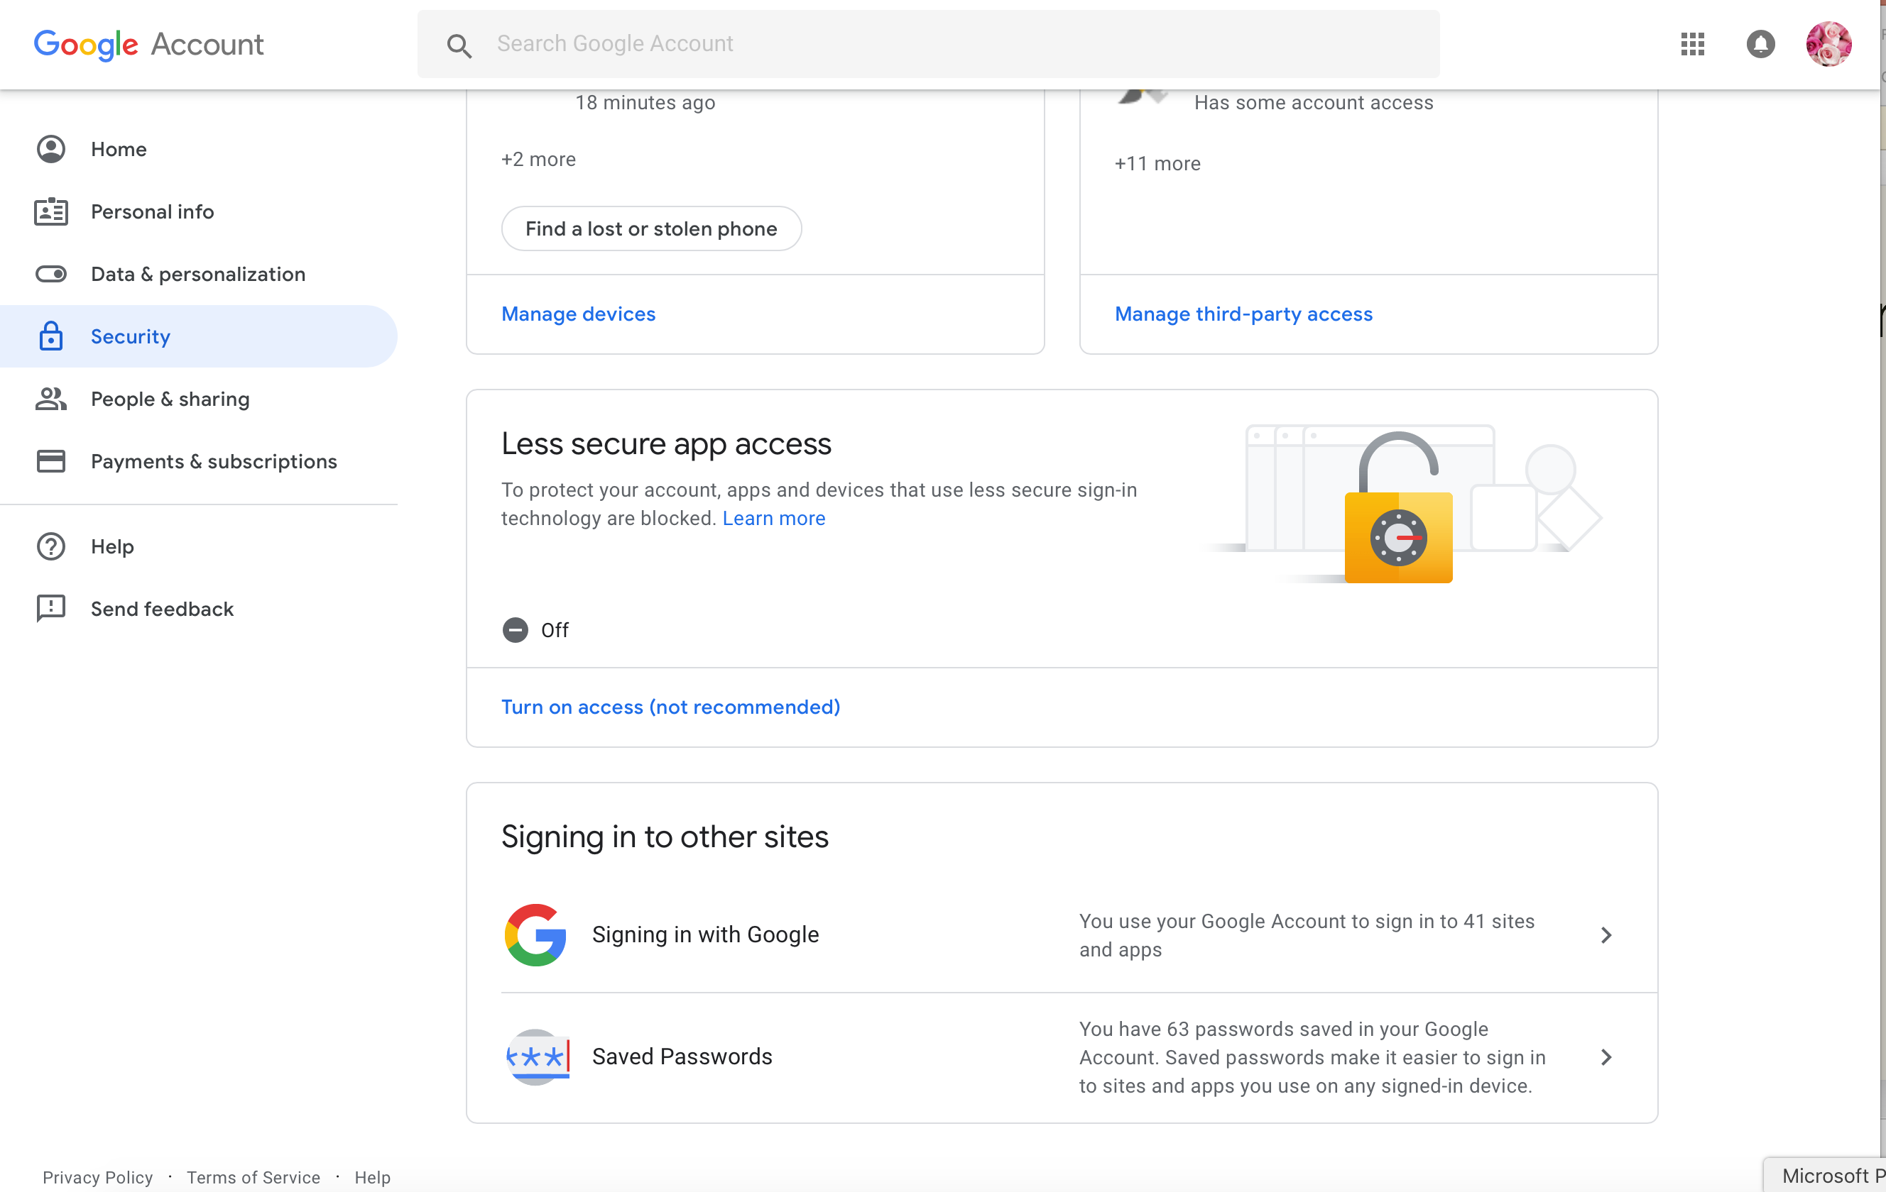
Configuring Gmail to allow sending Emails..
In “Less Secure App Access “ tab click on “Turn On Access”.

Slide 17
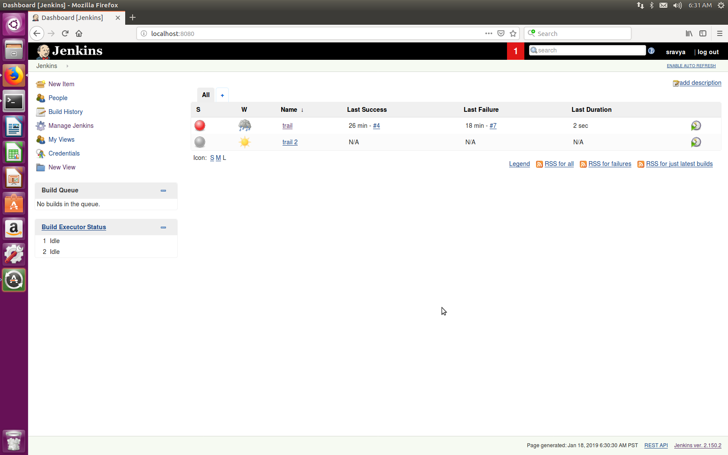
Adding Email Notifications to Project..
After Configuring Gmail and Jenkins, we need to configure the project to send email after build. We need to configure the recipient address.
On the Dashboard we can see the project name(“trail”) click on it.

Slide 18
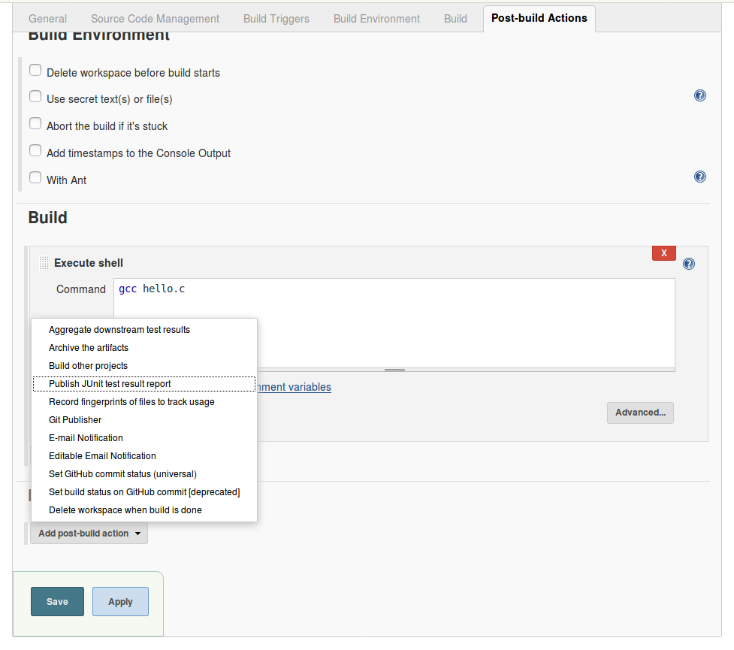
Adding Email Notifications to Project..
Click on “configure”
In the “Post Build actions tab” click on ”Add Post Build Action”.
In the drop down select “Email notification”

Slide 19
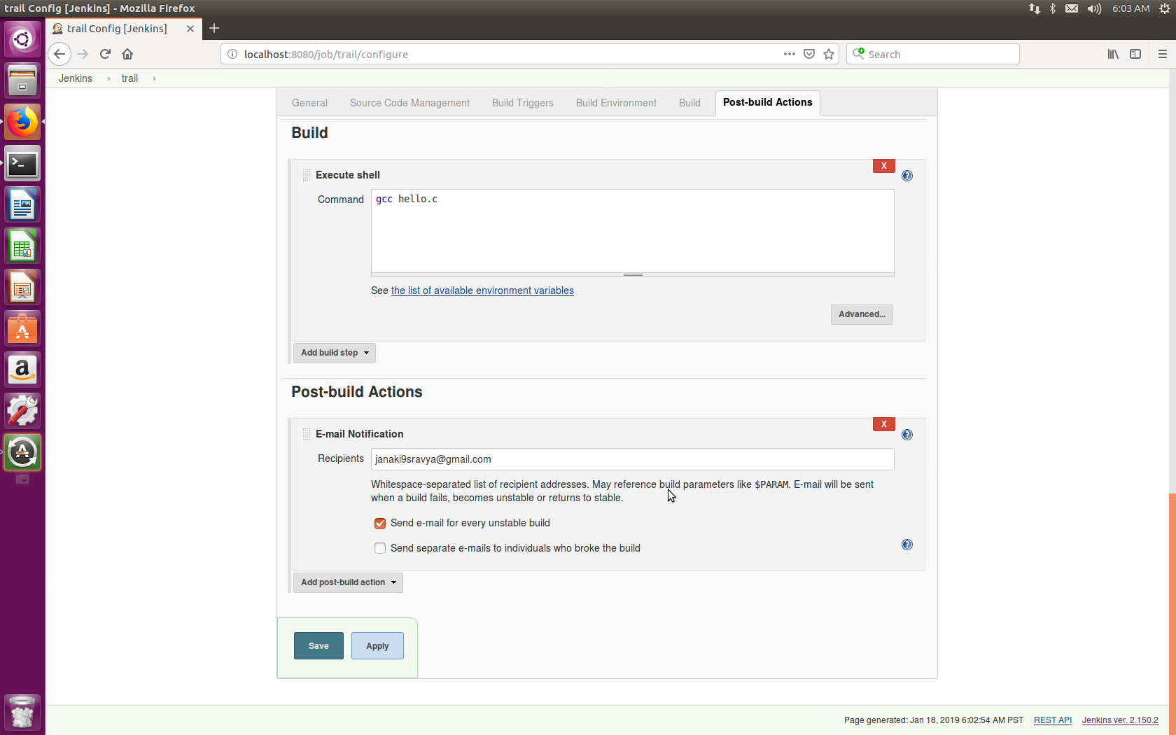
Adding Email Notifications to Project..
Add the “Recipient Email” in Email Notifications tab that appears.
Select “Send Email on Every Unstable Build” then save

Slide 20
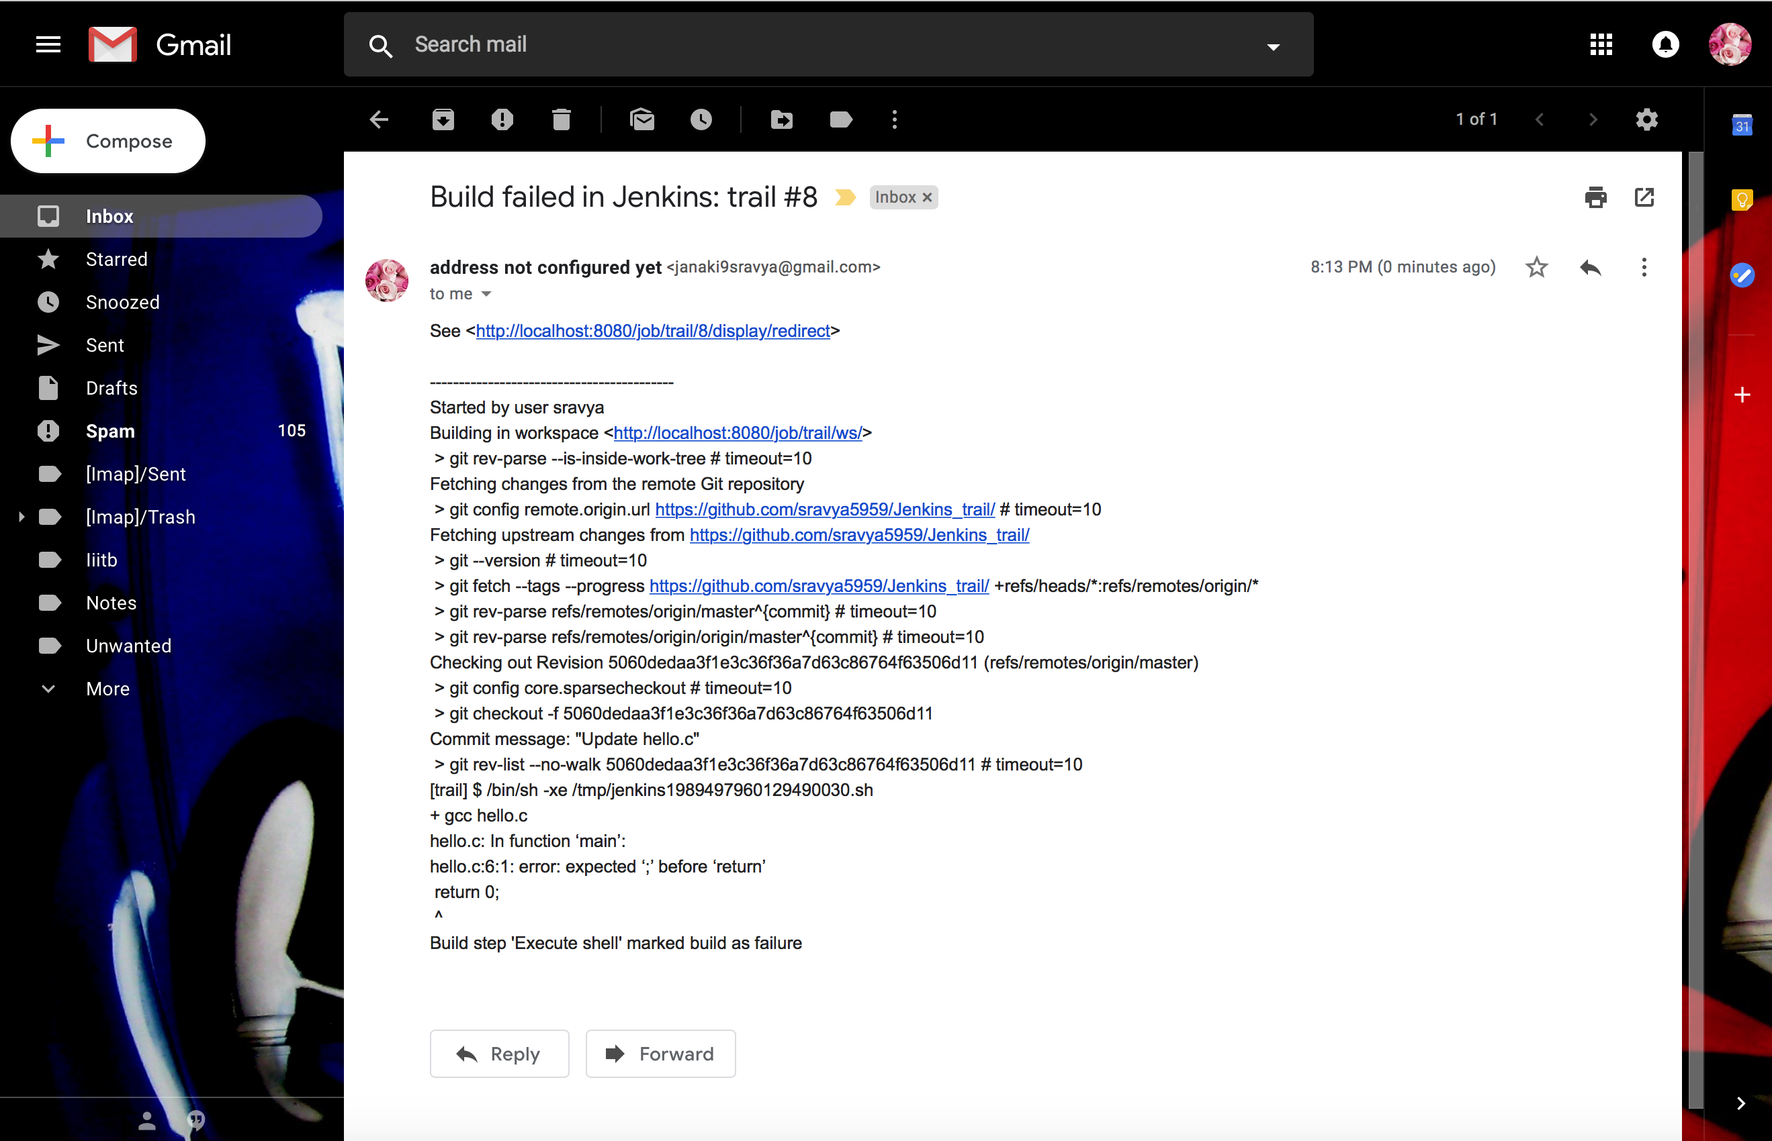
Check you email for Errors
Make some changes in the code to trigger errors.
Then build again. You can find an email on the recipient address stating the builld failure.

Slide 21
Thank You..

